Slide 1
Capstone Engagement
Assessment, Analysis, and Hardening of a Vulnerable System

Slide 2
Table of Contents
This document contains the following sections:
01
Network Topology
02
Red Team: Security Assessment
03
Blue Team: Log Analysis and Attack Characterization
Hardening: Proposed Alarms and Mitigation Strategies
04

Slide 3
Network Topology
3

Slide 4
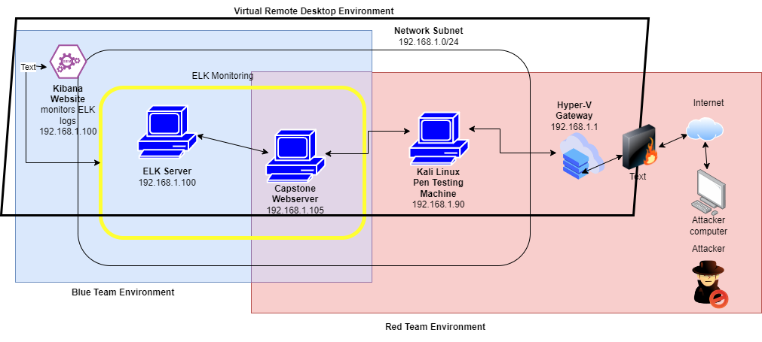
Network Topology
Network
Address Range: 192.168.1.0/24
Netmask: 255.255.255.0
Gateway: 192.168.1.1
Machines
IPv4: 192.168.1.1
OS: Windows 10
Hostname: Hyper-V
IPv4: 192.168.1.90
OS: Linux
Hostname: Kali
IPv4: 192.168.1.100
OS: Linux
Hostname: ELK Server
IPv4: 192.168.105
OS: Linux
Hostname: Capstone Webserver

Slide 5

Red Team
Security Assessment
5

Slide 6
Recon: Describing the Target
Nmap identified the following hosts on the network:
Hostname | IP Address | Role on Network
Hyper-V (Microsoft Corporation) | 192.168.1.1 | NAT switch
Pen Test System (Kali Linux) | 192.168.1.90 | Attack machine
ELK Server (Intel Corporate) | 192.168.1.100 | SIEM – monitoring and logging data
Capstone Webserver (Microsoft Corporation) | 192.168.1.105 | Capstone Webserver – target machine

Slide 7
Vulnerability Assessment
The assessment uncovered the following critical vulnerabilities in the target:
Vulnerability | Description | Impact
CWE-99: Improper Control of Resource Identifiers | Software does not restrict or incorrectly restricts input before it is used as an identifier for a resource. | Insecure ports allowed to remain open could allow an attacker access to the system. In this case, ports 23 and 80 remained open.
CWE-434: Unrestricted Upload of File with Dangerous Type | Ability to upload or transfer dangerous file types to gain access to webserver | Deployed a persistent reverse backdoor to Capstone’s Apache webserver, allowing access to directories and files.
CWE-312: Cleartext Storage of Sensitive Information | Sensitive information is saved in a cleartext (human readable) form, rather than being encrypted | An attacker can read and download sensitive information.
CWE-916: Use of Password Hash With Insufficient Computational Effort | Password hash is created but is stored in plaintext without using more advanced hashing protocol. | A non-hashed password is easily decoded, allowing an attacker to decode the password and gain unauthorized access.
Source: https://cwe.mitre.org/

Slide 8
Exploitation: Improper Control of Resource Identifiers
01
02
Tools & Processes
Used nmap to scan the network (192.168.1.0) for hosts and for open ports.
nmap -sn 192.168.1.0/24
nmap -sS 192.168.1.105
Achievements
Scan showed existing hosts of:
192.168.1.1 – NAT switch
192.168.1.100 – SIEM host
192.168.1.105 – Captstone Webserver
Showed open ports on Capstone Webserver of:
23 – Telnet, does not provide a secure connection like SSH to
manage network devices
80 – HTTP, which is the main protocol used by web browsers,
but is not secure, like 443 (HTTPS)

Slide 9
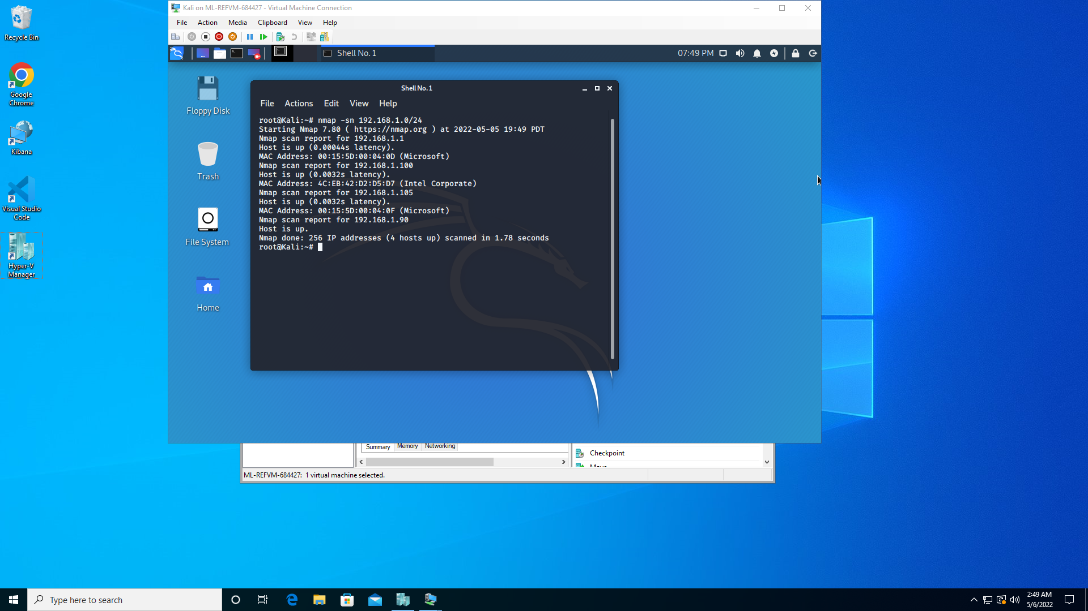
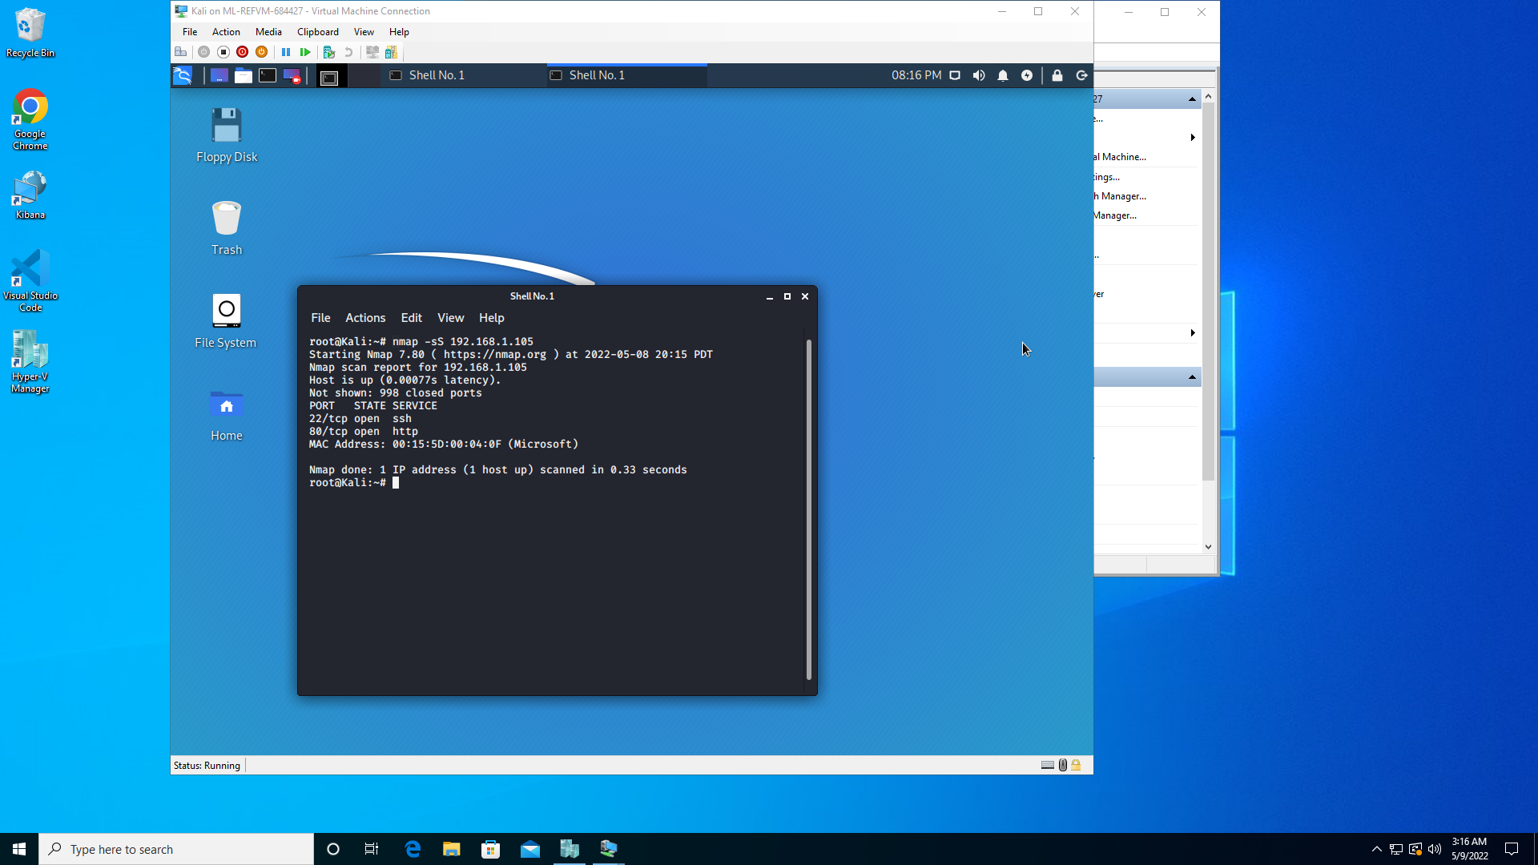
Exploitation: Improper Control of Resource Identifiers
03

Slide 10
Exploitation: Unrestricted Upload of Dangerous File
01
02
Tools & Processes
Used msfvenom to create a shell script payload
Used Metasploit tool suite to control and access the compromised Capstone Webserver (target machine)
Achievements
Successfully uploaded the created shell script payload to Webdav server on target machine.
Launched listener host and port. Gained remote access to target machine. Used remote access to locate and exfiltrate flat.txt file to Kali Linux (attacker machine)

Slide 11
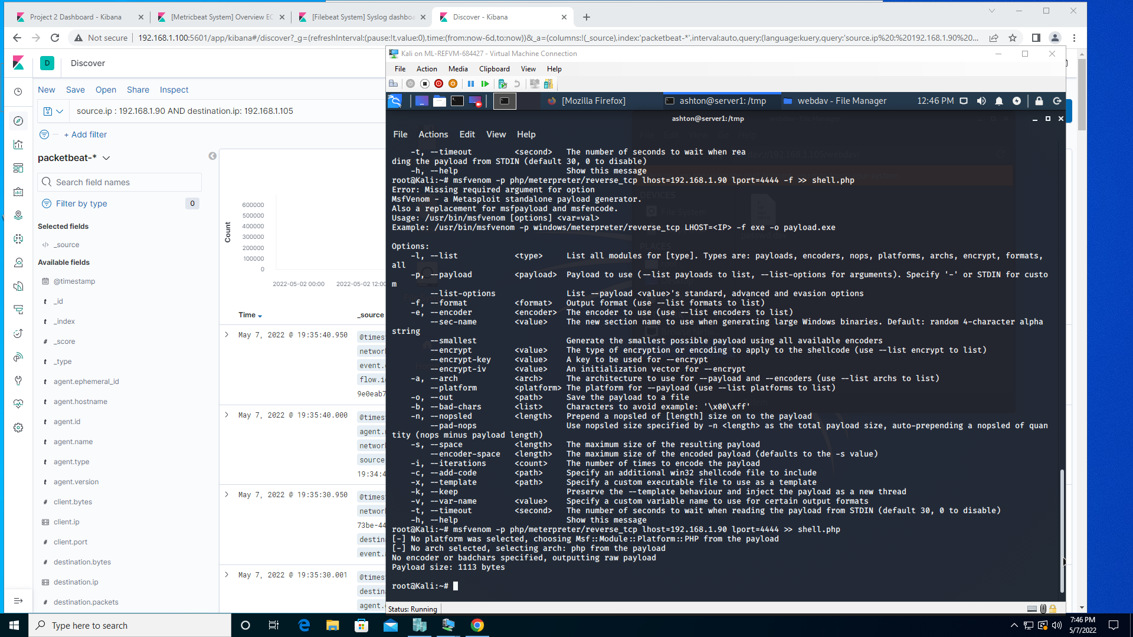
Exploitation: Unrestricted Upload of Dangerous File
03

Slide 12
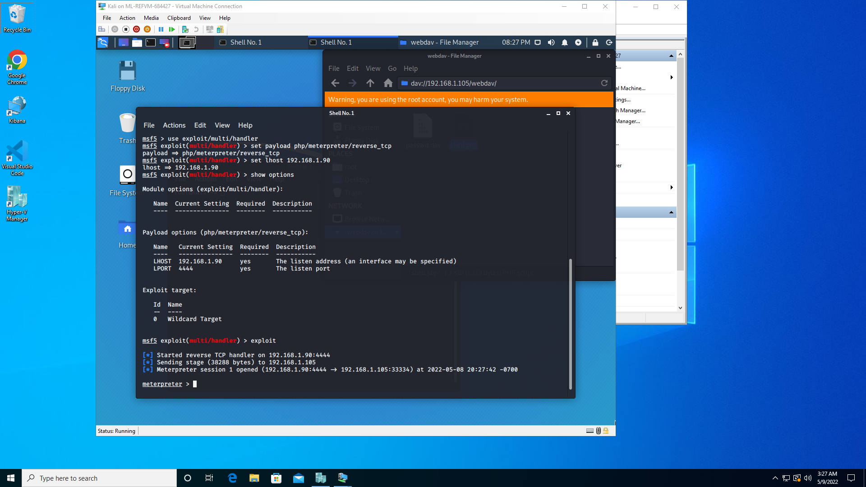
Exploitation: Unrestricted Upload of Dangerous File
03

Slide 13
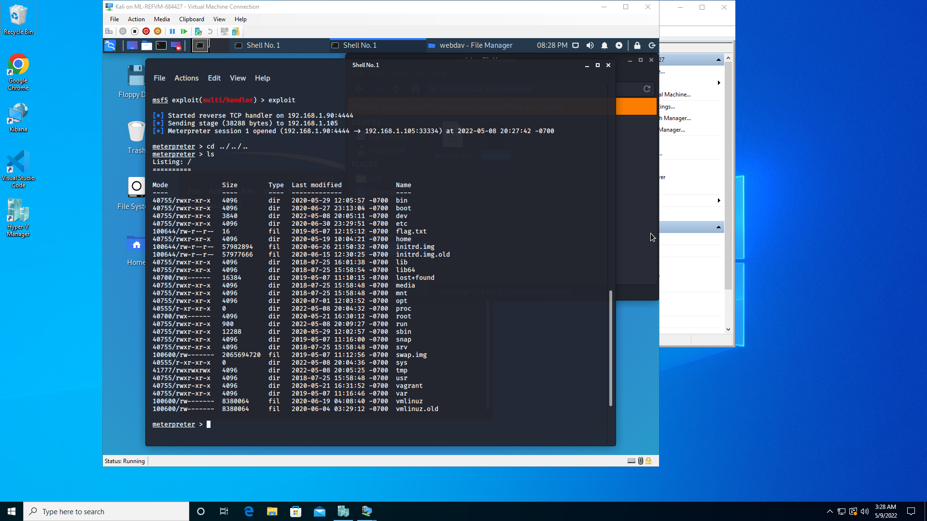
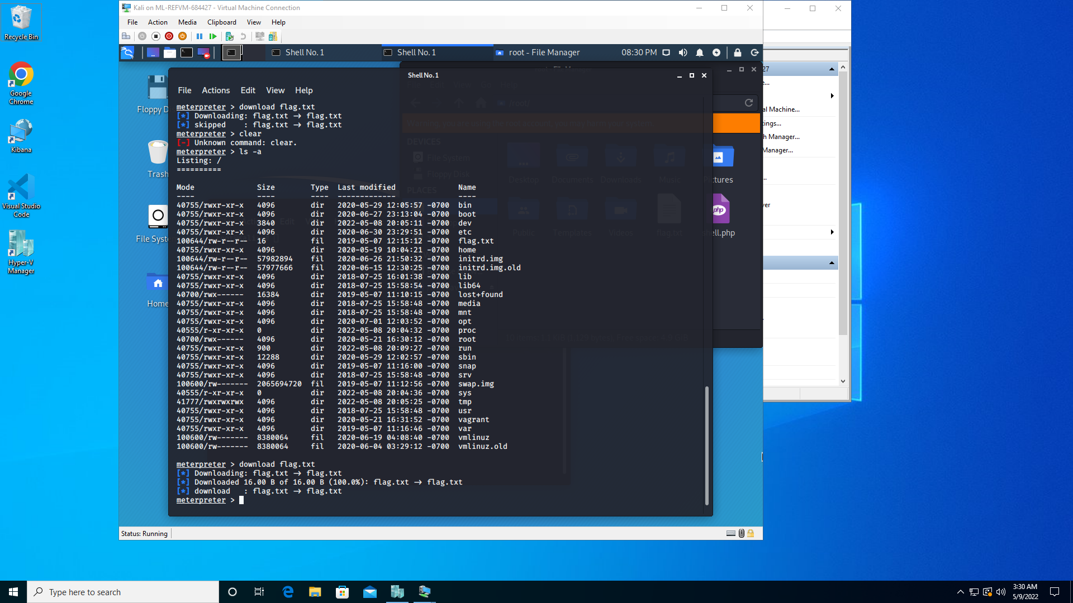
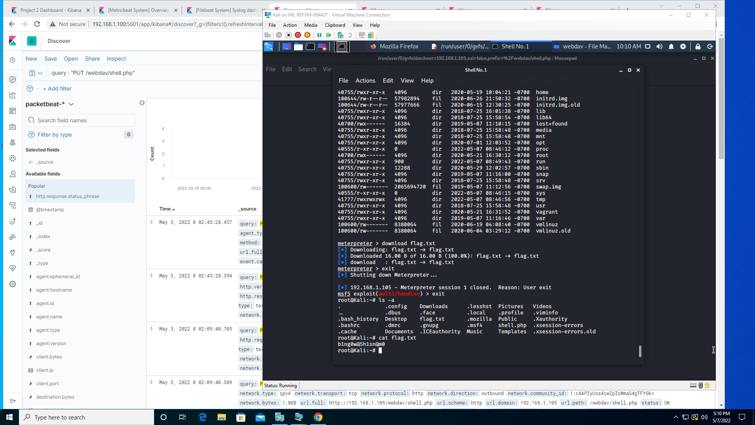
Exploitation: Unrestricted Upload of Dangerous File
03

Slide 14
Exploitation: Sensitive Information Stored in Cleartext
01
02
Tools & Processes
Web browser to gather sensitive information stored in human readable format. Information provided directory paths and login credentials needed to access system.
Hydra to break user password
Achievements
Website clearly indicated directory for “secret_folder”. Able to find team member responsible for the folder (ashton).
Used hydra to brute force password for Ashton. (see next weakness)
Successfully logged into the secret_folder directory to find cleartext file listing the username (ryan) for webdav server and the hash of his password, along with instructions for accessing the server. Replaced listed IP address with IP address found in nmap scan. Directory found at: http://192.168.1.105/company_folders/secret_folder/

Slide 15
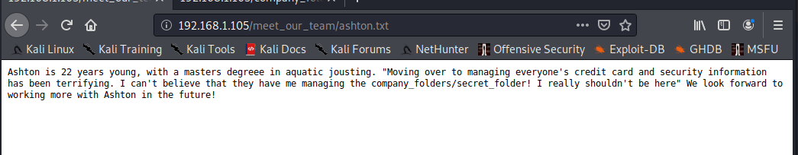
Exploitation: Sensitive Information Stored in Cleartext
03

Slide 16
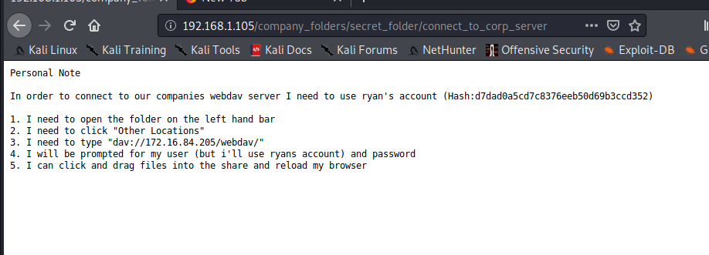
Exploitation: Sensitive Information Stored in Cleartext
03

Slide 17
Exploitation: Insufficiently hashed password
01
02
Tools & Processes
Used hydra to brute force password for username “ashton”.
Used Crack Station to brute force password for username “ryan”.
Achievements
Hydra command provided login credentials for ashton to access the secret_folder on the webserver.
The /secret_folder/ on the webserver provided, in cleartext, the unsalted hashed password for ryan to gain access to the target webserver and maneuver throughout their system to find the innocuous flag.txt file, but also the ability move around and change or exfiltrate any unsecured file.

Slide 18
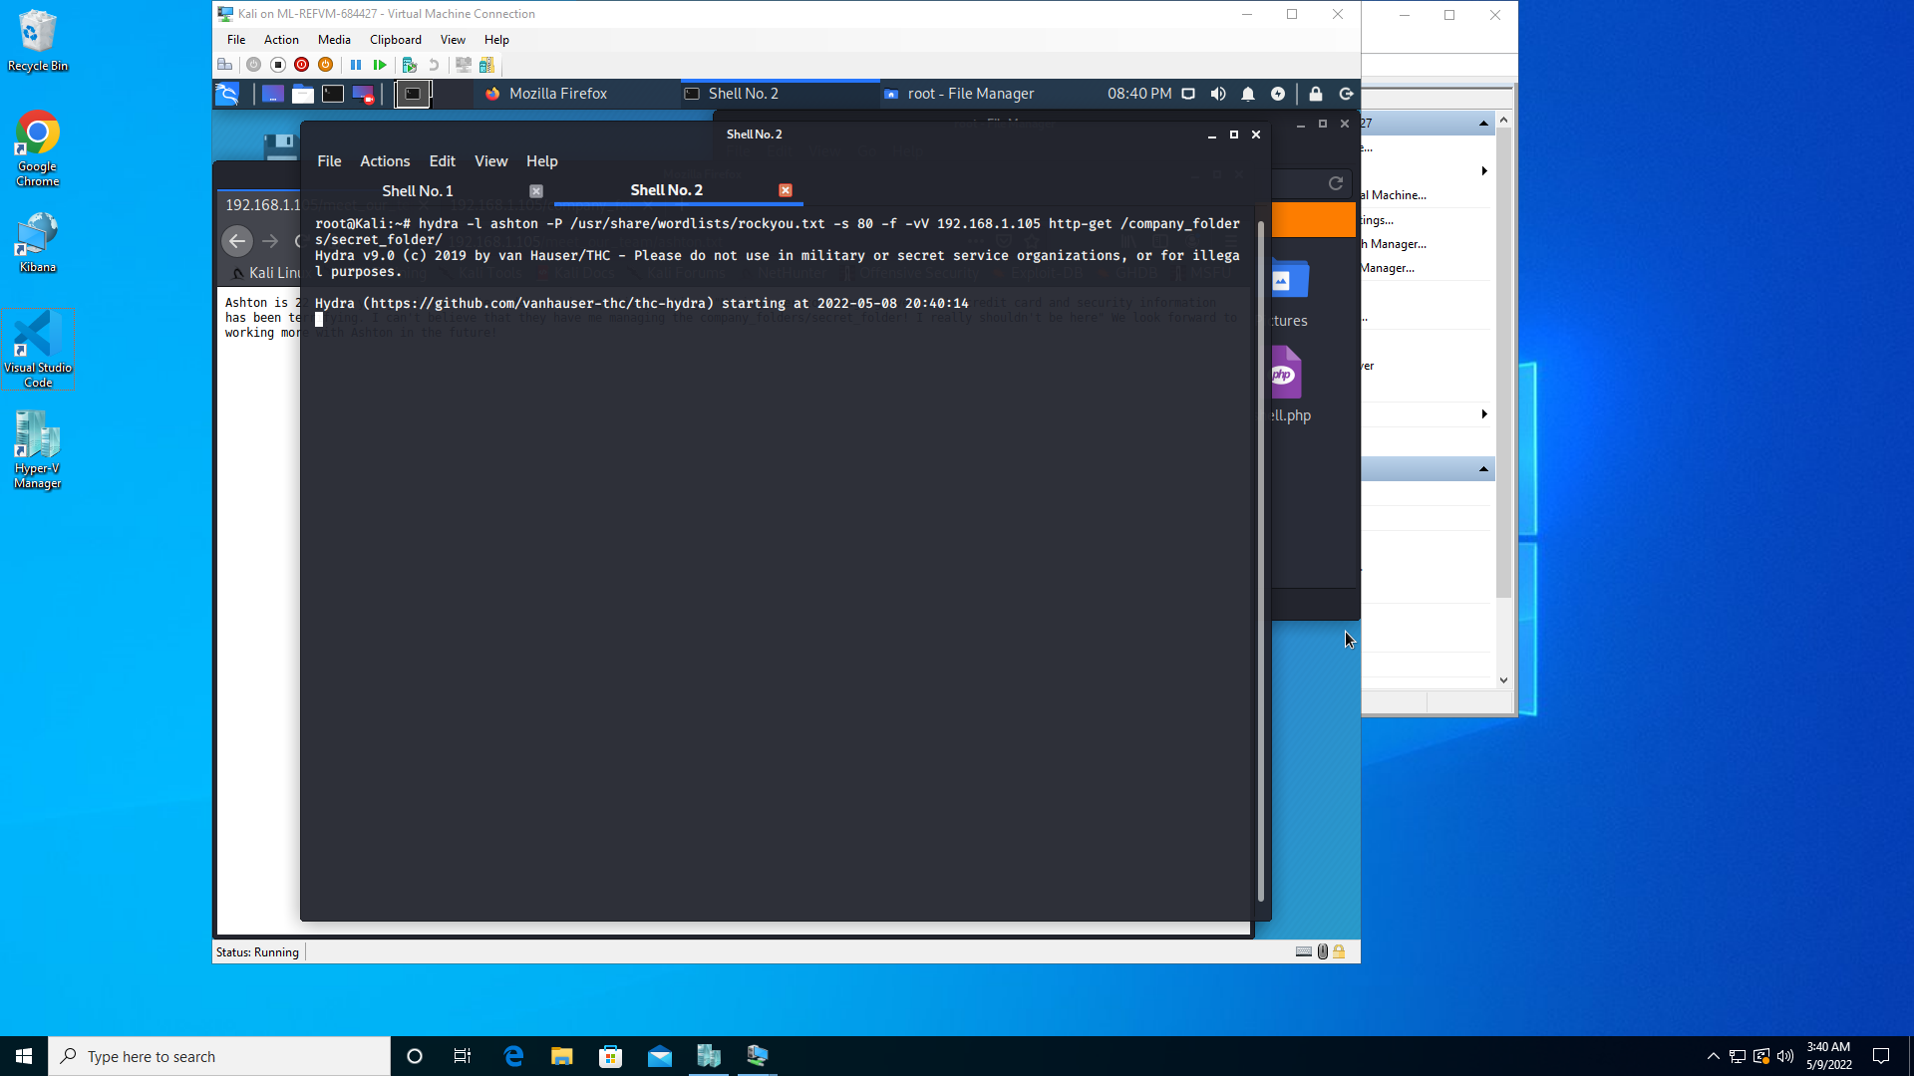
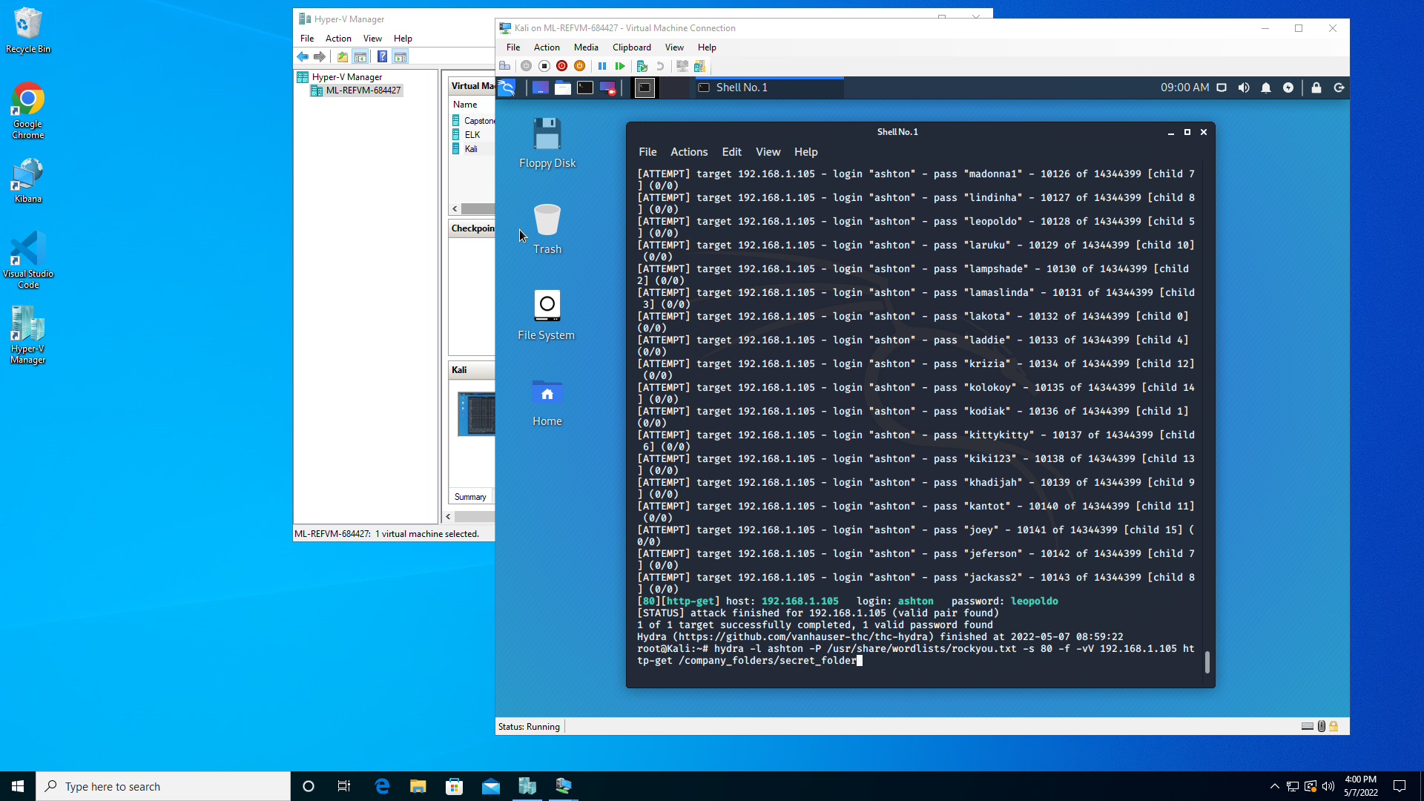
Exploitation: Insufficiently hashed password
03

Slide 19
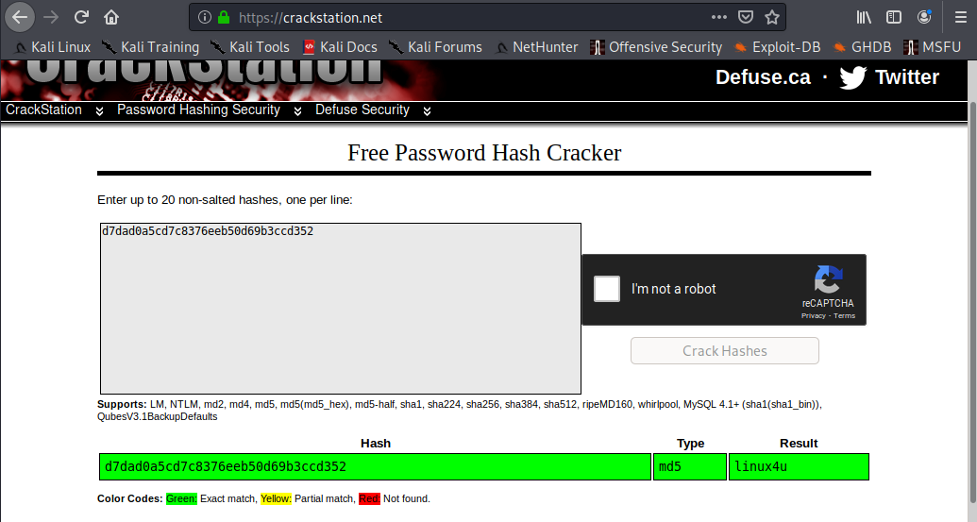
Exploitation: Insufficiently hashed password
03

Slide 20
Exploitation: Insufficiently hashed password
03

Slide 21
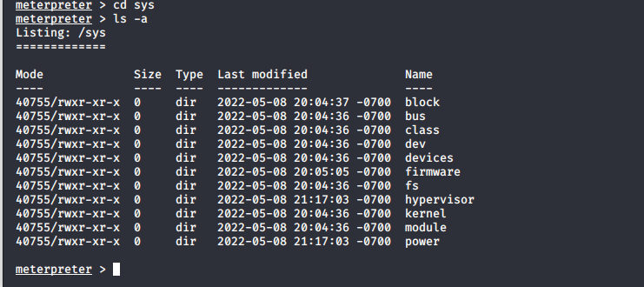
Exploitation: Insufficiently hashed password
03

Slide 22

Blue Team
Log Analysis and Attack Characterization
22

Slide 23

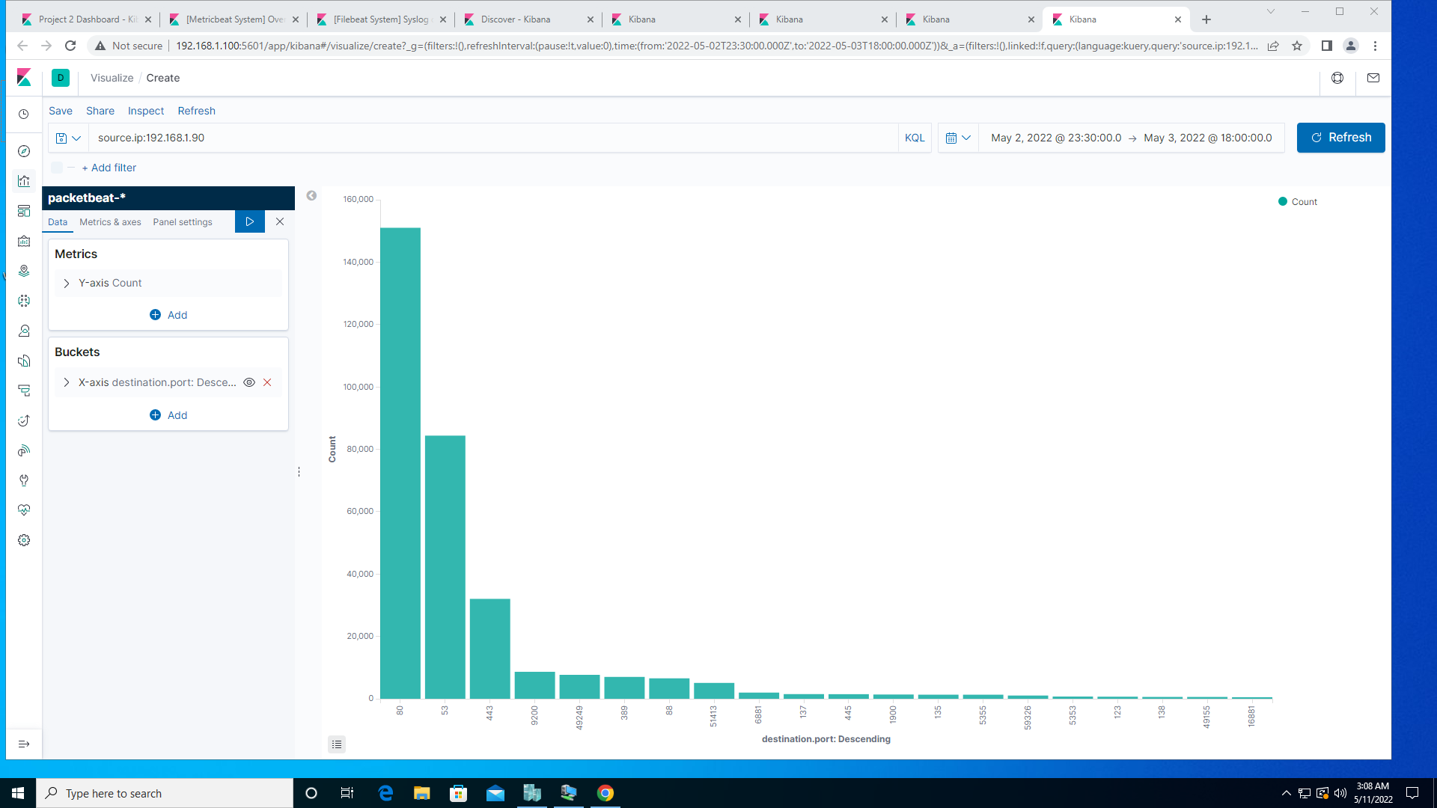
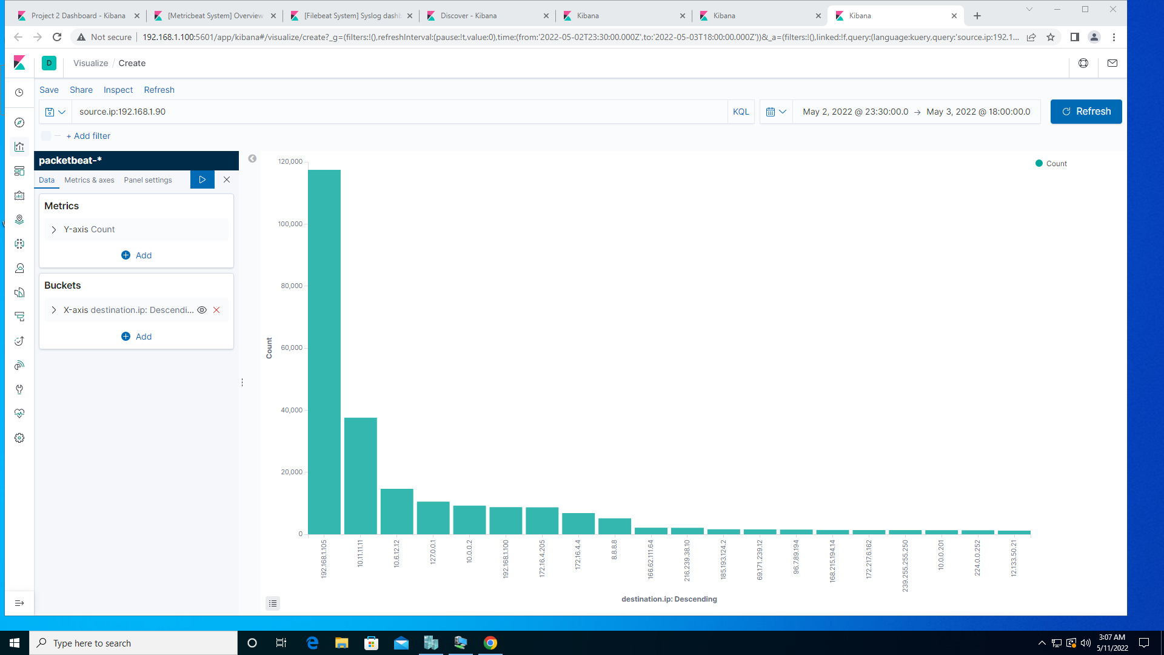
Analysis: Identifying the Port Scan
Scan began at 1:15:30am and ends at 1:18:30am
123,063 packets were sent from IP address192.168.1.90
High number of individual IP addresses scanned and ports scanned indicate an nmap scan

Slide 24
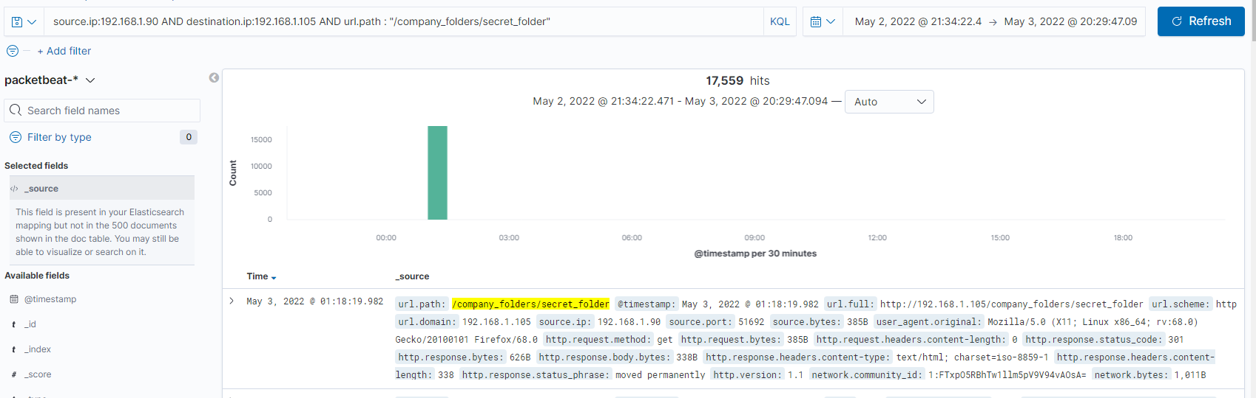
Analysis: Finding the Request for the Hidden Directory
The first request was received at 1:11 am. Final request received at 1:18 am. Total of 17,559 requests.
File requested was /company_folder/secret_folder. It contained the directions to access webdav and the username and unsalted hash of the user.

Slide 25
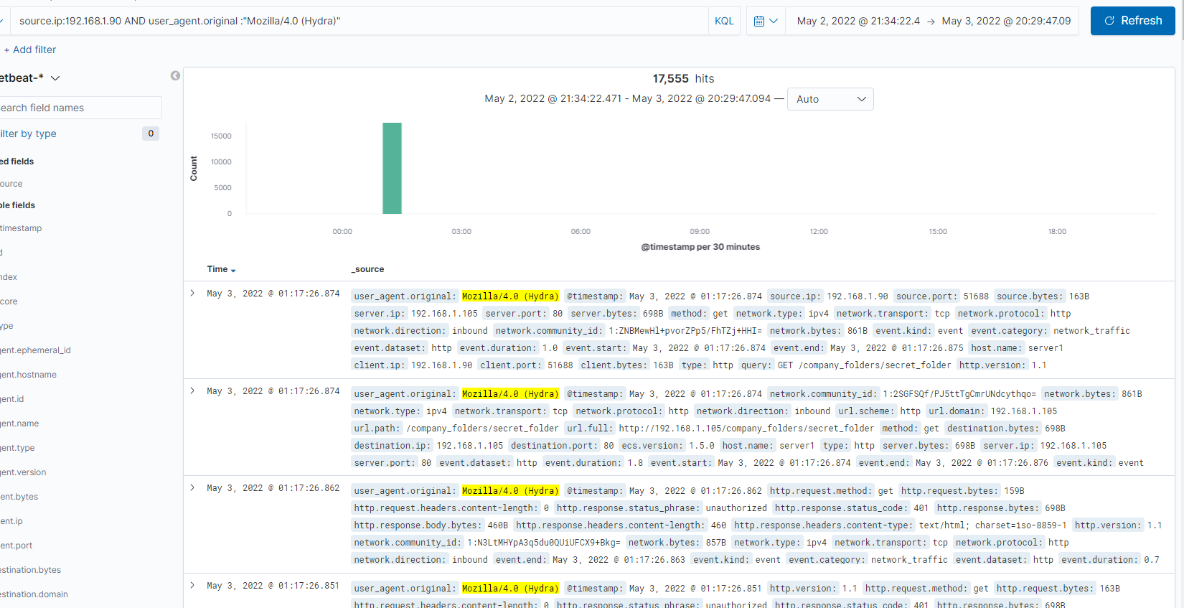
Analysis: Uncovering the Brute Force Attack
Requests from Hydra totaled 17,555
17,553 requests were sent before the webserver granted access to the secret_folder and provided the password

Slide 26
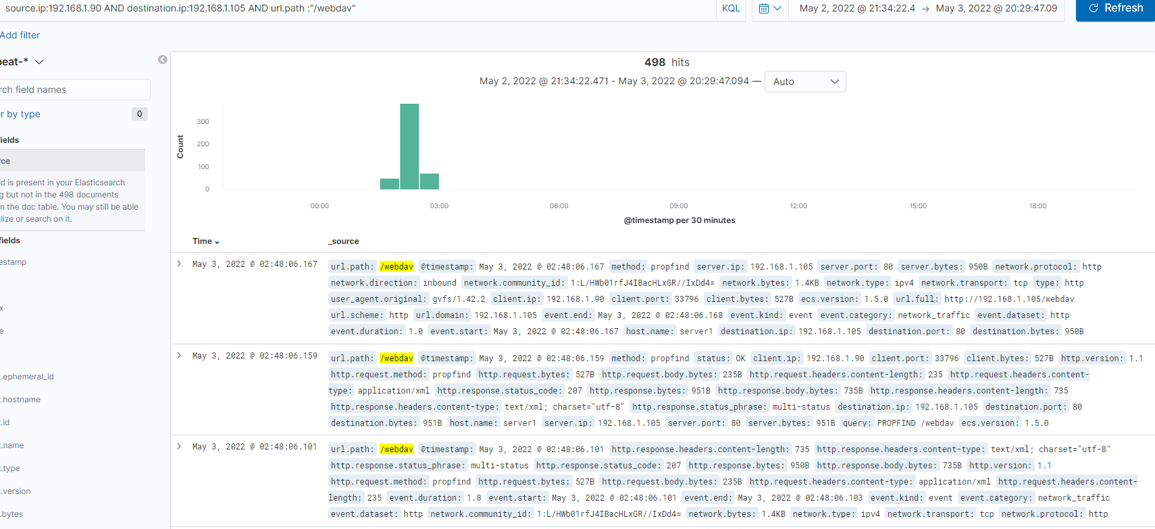
Analysis: Finding the WebDAV Connection
498 requests were made to access WebDAV
Files requested was the payload shell of /webdav/shell.php (200) and /webdav/passwd.dav (78)

Slide 27
Blue Team
Proposed Alarms and Mitigation Strategies
27

Slide 28
Mitigation: Blocking the Port Scan
To detect future port scans, set an alarm for any source IP that is not 192.168.1.105 and the port to any port that is not 443 or 80.
Report would be the number or port s accessed by source IP’s per second.
An email would be sent when more than 3 IP’s are detected.
Close ports 23 and 80 on IP 192.168.1.105
To close the ports, first you must know what services are using them, shut those down, or assign a different, secure port and then close the ports.
sudo netstat –tlnp
kill $pid
sudo fuser -k 23/telnet
sudo fuser -k 80/http
Marla Brannum - Red Vs Blue Team (Pen Testing and SOC Analyst Project) 5/3/22

Slide 29
Mitigation: Finding the Request for the Hidden Directory
Filter by IP address not among 192.168.1.100 or 192.168.105 and the url.path is *secret_folder*.
Report criteria would be the number of times the folder was accessed by external IP address.
Email would be sent when any access is attempted from any external IP.
For private files, deny read, write or execute privileges for anyone except the file owner. Set this in the http.conf file.

Slide 30
Mitigation: Preventing Brute Force Attacks
Create alert to trigger if any user id has 2 repeated account lockouts.
Report criteria would be to indicate any 401 error with the accompanying IP address and any 200 codes from an external IP.
Email would be sent when files exceed 5 for either code.
Require two factor authentication.
Require strong passwords (at least 15 characters) that must be changed at least every 6 months.
Establish 1 hour account lockout after 5 failed attempts in 15 minutes, with 3 lockouts requiring administrative assistance.

Slide 31
Mitigation: Detecting the WebDAV Connection
Alert when Webdav is accessed from any non-trusted IP address.
Report would indicate IP’s requesting access to Webdav.
Email would be sent when 5 attempts have been tracked.
Create whitelist of approved IP’s that are allowed to access the Webdav server.
Update httpd.conf file to block any disallowed IP addresses.

Slide 32
Mitigation: Identifying Reverse Shell Uploads
Set an alarm for attempted upload of any non-whitelisted file type.
Report would contain source IP address and file path and extension.
Email would be sent when any non-approved file type upload is attempted.
If files need to be uploaded to the webserver, create a whitelist of approved/allowed file types that may be uploaded. Any file type not on the list will be rejected.
Place the directory where files are uploaded outside of the website server.
Set a maximum file name length and max file size.
Update httpd.conf file to restrict approved IP addresses.

